Slide 1
INVESTING IN INDIA: KEY REGULATORY AND LEGAL TRENDS
27 February 2018

Slide 2
The Year Ahead

Slide 3
Key Policy Agenda
Making India a USD 5 trillion economy with sustained, comprehensive and holistic development by:
Ensuring an Investor friendly governance
Simplifying regulatory framework and minimizing governmental interference
Increasing accountability and building a transparent ecosystem
Deepen relations with nations to increase cooperation in sectors like health, information technology, energy, security and infrastructure
Fostering the government’s current initiatives like:
Ease of doing business
Digital India
Start up Initiative
Make in India
Incentivizing small and medium sized enterprises

Slide 4
Ease of Doing Business - Rank 2018 (1-190)

Slide 5
Foreign Direct Investment

Slide 6
Foreign investment in India in FY 2017-18

Slide 7
RECENTLY LIBERALIZED SECTORS
Single Brand Retail Trading
Construction Development
Defence
Financial Services
Pharmaceuticals
Civil Aviation

Slide 8
Insolvency and Bankruptcy Code

Slide 9
Insolvency & Bankruptcy Code – in a nutshell
Required boost to economy
Commercial considerations
Time bound process
Proof of debt
Automatic standstill
Evolving law – amendments already made
Improved position for overseas lenders
One stop shop
All creditors considered
Unique opportunity
Significant impact on India Inc. and banking sector
Untested option

Slide 10
Insolvency & Bankruptcy Code - Overview of NPA crisis
Rise in Gross NPAs

Slide 11
Insolvency & Bankruptcy Code - the Numbers at Play
Over 1300 Insolvency Resolution Professionals registered
10 NCLTs with
16 benches
Key statistics
Over 655 cases decided; including over 200 cases across various benches of NCLT other cases not admitted for resolution under law.
2017
108 insolvency proceedings initiated by corporate debtors
Over 461 corporates undergoing resolution as on Sep ’17
Over 540 insolvency applications have been admitted

Slide 12
Insolvency & Bankruptcy Code - Opportunities
Assets/ Equity Buyout
Time bound & transparent process
Opportunity to bid for good quality assets at deep discounts
Difficult for promoters to bid
Large haircuts for lenders
Interim Finance
Cost of interim finance is included in process costs
Top in priority list of repayment
Assured repayment
Existing lenders wary
15-22% interest demanded by ARCs
12

Slide 13
Insolvency & Bankruptcy Code - Issues
Resolution plan must provide for:
appropriate management of affairs of corporate debtor
continuation of corporate debtor as “going concern”
method of implementation of resolution plans
SEBI exemptions for Takeover Code and ICDR available, but not for delisting
Payment of MAT on write-down of loans – Written down amounts to be accounted for as book profits - subject to 18.5%++ MAT
Savings of tax losses: Carry forward of business losses & unabsorbed depreciation lost on change of control
Competition law clearance required for distressed transactions in certain sectors such as cement or steel

Slide 14
GST Regime

Slide 15
GST - One country - 0ne tax
Common market: A common market aimed at unification & harmonization of tax rates, classification of goods & compliance
Reduction of cascading of taxes: Tax set-offs available across production value-chain, both for goods and services. Aimed towards bringing down overall cost of goods and services and therefore doing business in India
Exclusion from GST: Alcohol, petroleum products and electricity are kept outside of GST. However, government has given signals to include petroleum products in long run
Compliance issues: While it has been over six months since introduction of GST regime, industry is still plagued by inefficiencies in GST Network
Multiplicity of GST rates is a challenge: GST has tax-slabs of 0, 5, 12, 18, 28% and various cess rates on different products such as high end cars and tobacco products defy one tax objective
Anti-profiteering: The requirement to reduce costs of products if the suppliers are reaping benefits under the GST regime is affecting sectors like FMCG and Textile

Slide 16
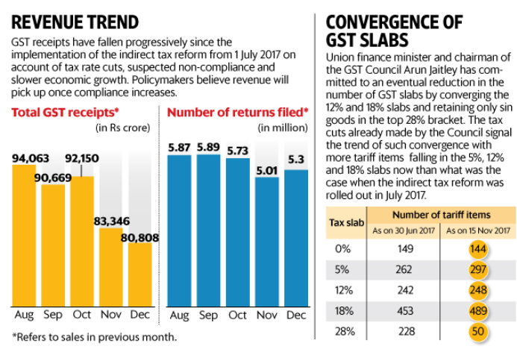
GST- Early indicators and trends

Slide 17
Dispute Resolution in India

Slide 18
RECENT REFORMS
Amendments to the legislation governing Arbitrations:
In line with the New York Convention 1958
Fast Track Procedure
Minimized judicial intervention especially in respect of challenge and enforcement of arbitral awards
Transparency from Arbitrators
Recent judgements increased investor protection
Steps taken to promote Institutional Arbitration
Commercial courts for high value commercial transactions

Slide 19
Digital Economy – Scope for Fintech in wake of Demonetisation

Slide 20
Demonetization
What missed?
Almost 99% of cash re-deposited
Slow down in GDP growth
CMIE - 50 day hit on economy US$ 20b
250,000 units in unorganised sector closed
Sectors in red: Real estate, agriculture, auto, manufacturing, construction & retail
Cash-to-GDP ratio back to double-digits
What worked?
Digital payments up by 56% (till end May’17)
Tax returns up from under 10% to 25% in Aug ’17
37,000 shell companies identified, 300,000 under scanner, 400 unscrupulous transactions worth US$ 94m under investigation
Zero balance accounts under financial inclusion scheme down from nearly 77% in Sep ‘14 to about 21% in Aug ‘17

Slide 21
Projections & Reforms Expected
Budget 2018:
Government backing for fintech start ups
Greater focus on Digital India plan
Outlay of USD 30 billion for the technology sector
Positive policy environment
Indian fintech market projected to touch USD 2.4 billion by 2020
Highest expected rate of return in India at 29% versus global average of 20%
Second fastest country to adopt fintech technologies in the world

Slide 22
Thank You

